Slide 1
Genre Based Sentimental Analysis of Movies using NLP
A presentation by Shruti Vangari

Slide 2
“What is in a Name?”
“The establishment or starting point of an institution or activity” NEUTRAL
Movie | Budget | Revenue | Rating
Inception | $160 m | $292 m | 8.4/10
The Shawshank Redemption | $25 m | $28 m | 9.2/10
“The action of saving or being saved from sin, error, or evil” POSITIVE

Slide 3
Genre Based Classification
Genre – “a style or category of art, music, or literature”
Short | Fantasy
Drama | Mystery
Comedy | Sci-Fi
Documentary | Musical
Adult | Western
Romance | Biography
Action | Sport
Animation | History
Thriller | War
Family | Reality-TV
Crime | News
Adventure | Talk-Show
Music | Game-Show
Horror | Film-Noir

Slide 4
NLP (Natural Language Processing)
Interaction of Human language and computers
Turing Test by Alan Turing
Latest development is SIRI
Sentimental Analysis
Branch of Data Mining
Polarity of a word can be classified as positive or negative

Slide 5
Algorithm used at the Clause Level
FOR each sentence
Perform Semantic Annotation
Assign prior sentiment scores to words
Generate grammatical dependencies
Break a sentence into clauses
FOR each clause
Calculate clause level Sentiment Score (Single Aspect)
Subject or Object (Adjective + Noun)
Verb phrase (Adverb + Verb)
Predicate (Verb phase + Object/Complement)
Clause (Subject and Predicate)
Determine Aspect
END FOR
END FOR

Slide 6
Dataset(s)
Movie Name Rating (10)
A 9
B 8
Based on Rating
Genre Based
Movie Reviews
Movie Names
Movie Name Genre
A Action
B Drama
“This movie was awesome!” “The worst of the worst movies this year!!”
Movie Name
Positive
(Compared to Rating)
Negative

Slide 7
Experiments using WEKA
Waikato Environment for Knowledge Analysis
Dataset with Rating
Dataset with Genre
Input =
Dataset with rating for a genre
WEKA
Output = Distribution classified by genre to show which gets highest rating

Slide 8
Experiments using Stanford CoreNLP
Input = Movie Names Dataset Or Movie Reviews Dataset
Positive words file
Negative words file
Stanford CoreNLP
Output =Statistical Data
# Positive words = p
# Negative words = n
# Neutral words = nw

Slide 9
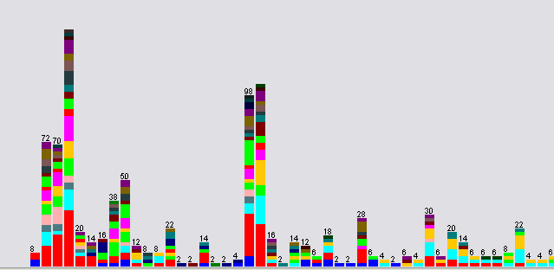
Results from WEKA – Rating Based

Slide 10
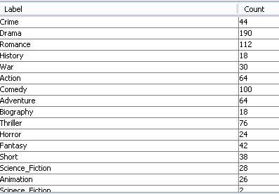
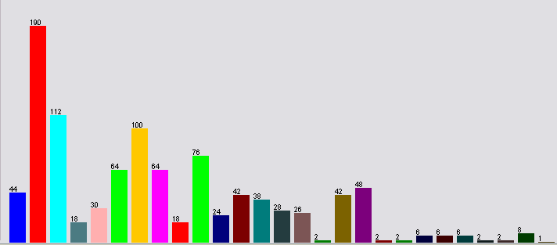
Results from WEKA – Genre Based

Slide 11



Results from Stanford CoreNLP
Top 10 Movie Ratings
Bottom 10 Movie Ratings
All Movie Names

Slide 12
Questions??

Slide 13
Thank You! ☺

